Slide 1

Thermal Management System For Electric Vehicles
Group No:12
Group members Reg No:
B. ROHIT BETHALA: 2110040094
JASHWANTH REDDY: 2110040057
REVANTH : 2110040047
J. VIGNESH : 2110040061
CHETTAMAINA AJAY: 2110049136
K. SATHWIK GOUD: 2110040065

Slide 2

Contents
Introduction
Block diagram
Circuit Diagram
Screenshot of simulation results
Current status of project
Work to be done before review 2
Conclusion-Learnings

Slide 3
Introduction
Mention a few points about the project topic like
Problem statement
Importance
Applications

Slide 4
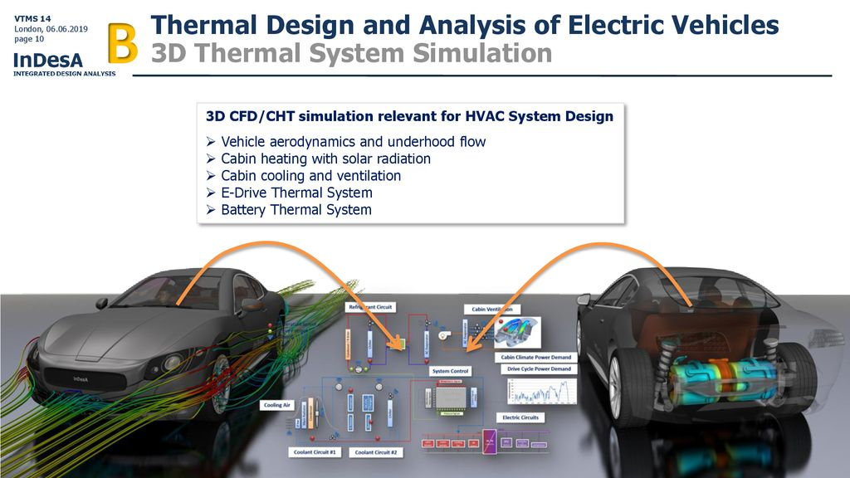
PROBLEM STATEMENT
Nowadays electric vehicles have increased over the past decade as consumers demand more eco-friendly solutions to combat climate change. Recently Some Electric bikes caught fire due to the failure of the battery Management system, and bad battery design. Due to the Absence of a Thermal Management system Notification Alert (Battery Temperature), some people have lost their life.
Overheating is one of the major causes that accelerates the rate of battery degradation in electric vehicles. Heat generation makes the battery work hard and causes its performance to deteriorate over time. The direct current fast charging and rapid charging of the battery are not good for battery health, as the accelerated electric currents create higher temperatures.

Slide 5
IMPORTANCE
The importance of a battery cooling system in electric vehicles cannot be overstated. Here are some of the reasons why it is essential:
Battery Life: A battery cooling system helps to extend the life of the battery. When the battery is exposed to high temperatures, it can cause the cells to degrade more quickly. A cooling system ensures that the battery remains at a stable temperature, reducing the rate of degradation.
Performance: The performance of the battery is affected by temperature. When the battery is too hot or too cold, it can cause a reduction in the power output, making it difficult to start the vehicle. A cooling system helps to maintain the optimal temperature range, ensuring consistent power output and better vehicle performance.
Safety: Lithium-ion batteries used in electric vehicles can catch fire if they are exposed to high temperatures or if there is a thermal runaway event. A cooling
system helps to prevent such events by keeping the battery at a stable temperature and preventing the cells from overheating.
Range: The range of an electric vehicle is directly related to the battery's performance. By maintaining the battery at an optimal temperature range, a cooling system helps to improve the battery's efficiency, allowing the vehicle to travel further on a single charge.

Slide 6
APPLICATIONS
There are several advantages to having a battery cooling system in electric vehicles, including:
Increased Battery Life: A battery cooling system helps to keep the battery at an optimal temperature range, which can extend the life of the battery. This is because high temperatures can cause the battery to degrade faster, reducing its overall lifespan.
Improved Performance: When the battery is at the optimal temperature range, it can deliver consistent power output, leading to better performance of the electric vehicle. This means better acceleration, speed, and range.
Increased Efficiency: The battery cooling system helps to maintain the battery's temperature range, which can improve the overall efficiency of the battery. This, in turn, can increase the range of the electric vehicle and reduce the frequency of recharging.
Enhanced Safety: Lithium-ion batteries used in electric vehicles can catch fire if they are exposed to high temperatures or if there is a thermal runaway event. A cooling system helps to prevent such events by keeping the battery at a stable temperature and preventing the cells from overheating.
Reduced Maintenance: Electric vehicles with a battery cooling system require less maintenance compared to those without one. This is because the cooling system helps to protect the battery from damage, reducing the need for repairs or replacements.

Slide 7
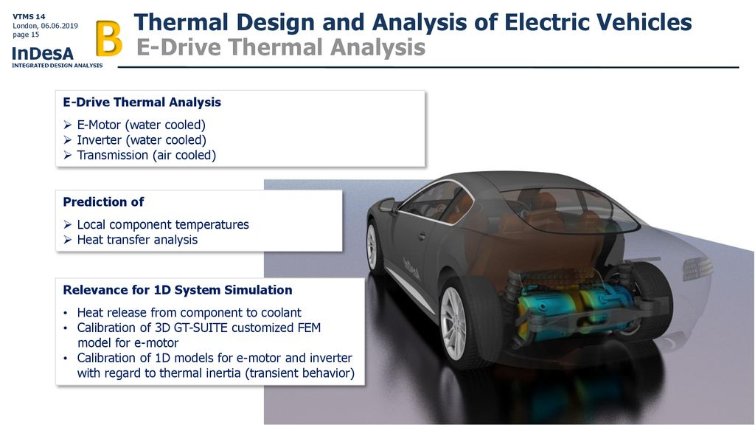

Slide 8


FIRE ACCIDENTS OF ELECTRIC VEHICLES

Slide 9
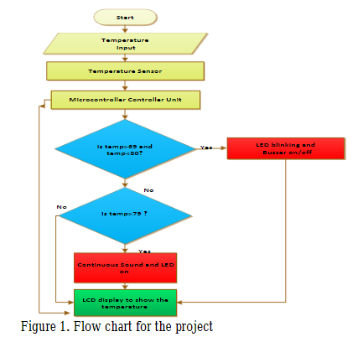
Circuit diagram of project work

Slide 10

IMPORTANCE
Electric Vehicle unexpected Battery Fire Accident cause loss of human life, Damaging of Electric vehicles happens when Electric Vehicle user are not alerted immediately. When this problem is analysed and immediate alert will be sent to Electric Vehicle user’s this will help in avoiding loss of human life and Electric vehicle damages. The objectives and the points that we achieved due to the developed system are shown below
Monitoring the Battery Temperature and smoke to alerting users via buzzer and smartphone notification all the time.
Auto cut-off the battery power from the Electric Vehicle to avoid further damages.

Slide 11
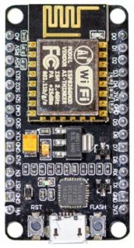
COMPONENTS USED
NODE MCU
The No demcu (Node Microcontroller Unit) is an open-source software and hardware development environment built around an inexpensive System-on-a-Chip (SoC) called the ESP8266. The ESP8266, designed and manufactured by Expressive Systems, contains the crucial elements of a computer: CPU, RAM, networking (Wi-Fi), and even a modern operating system and SDK. That makes it an excellent choice for Internet of Things (IoT) projects of all kinds.

Slide 12
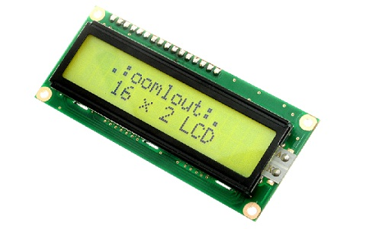
Liquid crystal display (LCD):
The term LCD stands for liquid crystal display. It is one kind of electronic display module used in an extensive range of applications like various circuits & devices like mobile phones, calculators, computers, TV sets, etc. These displays are mainly preferred for multi-segment light-emitting diodes and seven segments. The main benefits of using this module are inexpensive; simply programmable, animations, and there are no limitations for displaying custom characters.

Slide 13
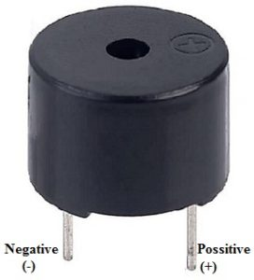
BUZZER:
An audio signalling device like a beeper or buzzer may be electromechanical or piezoelectric or mechanical type. The main function of this is to convert the signal from audio to sound. It is powered through DC voltage and used in timers, alarm devices, printers, alarms, computers, etc. Based on the various designs, it can generate different sounds like alarm, music, bell & siren.
The pin configuration of the buzzer is shown below. It includes two pins namely positive and negative. The positive terminal of this is represented with the ‘+’ symbol or a longer terminal. This terminal is powered through 6Volts whereas the negative terminal is represented with the ‘-‘symbol or short terminal and it is connected to the GND termin

Slide 14
BLOCK DIAGRAM OF PROJECT WORK

Slide 15
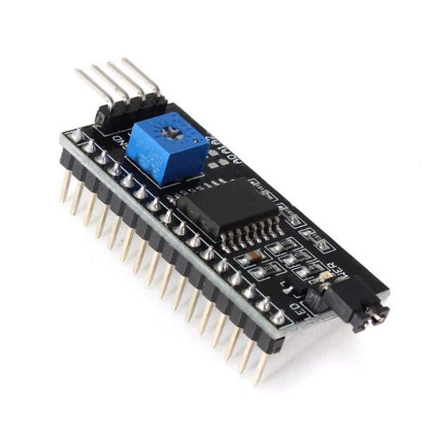
I2C MODULE:
I2C Module has a inbuilt PCF8574 I2C chip that converts I2C serial data to parallel data for the LCD display.
These modules are currently supplied with a default I2C address of either 0x27 or 0x3F. To determine which version you have check the black I2C adaptor board on the underside of the module. If there a 3 sets of pads labelled A0, A1, & A2 then the default address will be 0x3F. If there are no pads the default address will be 0x27.
The module has a contrast adjustment pot on the underside of the display. This may require adjusting for the screen to display text correctly.

Slide 16
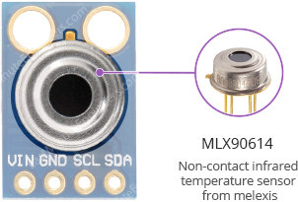
MLX90614 Non-contact Infrared Temperature Sensor
At the heart of the module is a high precision non-contact infrared temperature sensor from melexis – MLX90614. Unlike most temperature sensors, this sensor measures temperature without being physically touched. This can be very useful for monitoring the temperature of something moving like a spinning motor shaft or objects on a conveyor belt for example. Simply point the sensor at what you want to measure and it will detect the temperature by absorbing the emitted IR waves

Slide 17
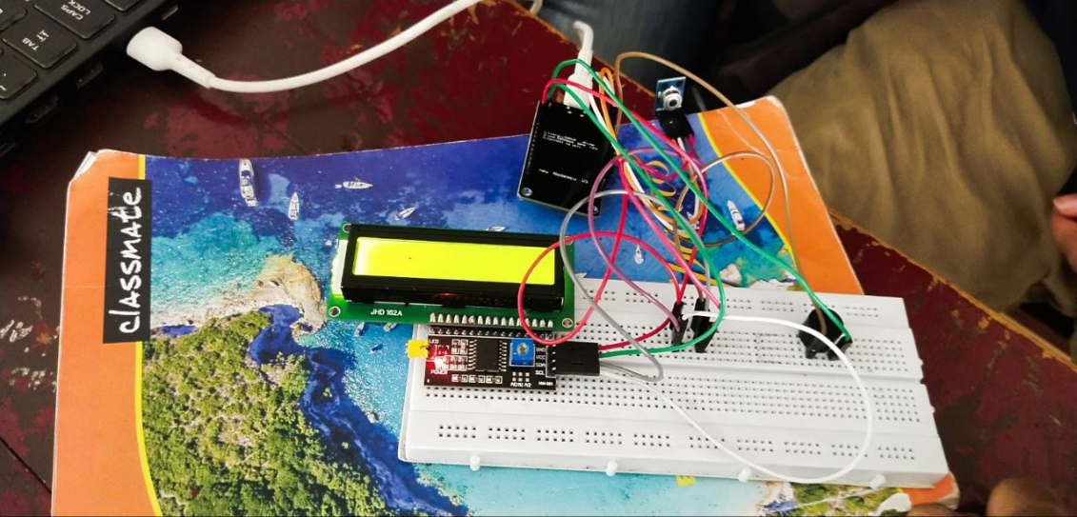
REAL WORLD BOARD OF THE PROJECT

Slide 18
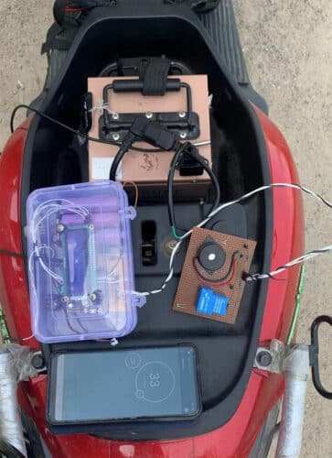
SET UP OF THE PROJECT

Slide 19
PROCEDURE
The circuit is connected to a 6 volt DC power supply. Pin 2,3,4,6,11,12,13 of micro-controller AT mega 8 is connected with LCD via variable resistor. In temperature sensor pin 1, 2 and 3 are GND, DQ and VCC respectively.
Pin 14 of micro-controller is directly connected with pin 2 DQ of temperature sensor. In temperature sensor pin 3 VCC is connected to the pin 2 DQ via 4.7k resistor and pin 1 is ground.
Pin 15 and 16 of micro-controller is connected to the buzzer and LED respectively. When temperature is greater than 69, buzzer and LED at flip-flop stage i.e. LED blinking and buzzer on-off
When temperature is greater than 79 buzzer and LED continuously on stage (Figure 4).Here any temperature can be set. Outside that condition the system is continuously show operating temperature of battery

Slide 20
COMPONENTS LIST
NODE MCU
Liquid crystal display (LCD):
BUZZER:
I2C MODULE:
MLX90614 Non-contact Infrared Temperature Sensor
BT1-12V Lithium-ion Battery
IDE Arduino Software

Slide 21
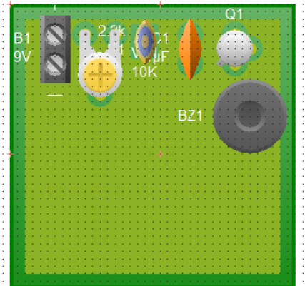
REAL WORLD BOARD OF THE PROJECT

Slide 22
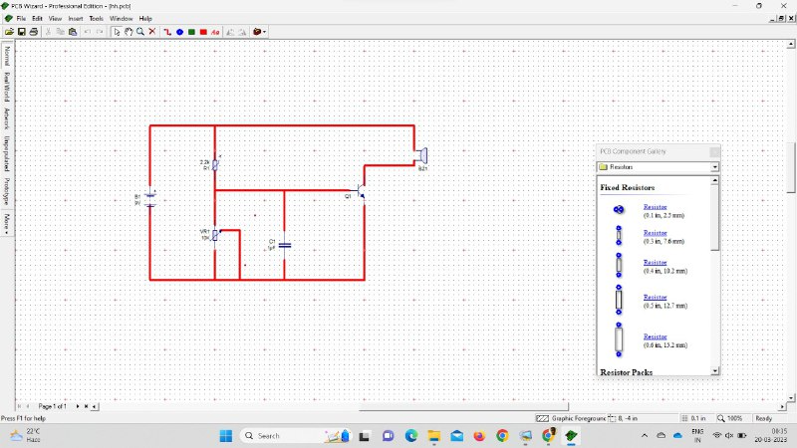
simulation results BEFORE SIMULATION in PCB wizard

Slide 23
COMPARATIVE MARKET STUDY
FEATURES
Technology components to be involve are
It can be used to detect the temperature of the product and alert immediately
Existing Product: product developed by automotive companies
MARKET AND TARGET CUSTOMERS: customers are automotive companies and individual passengers for building a cost free efficient product
PRICE :we are designing a low cost Thermal Management System For Electric Vehicles for user friendly and feasability
BT1-12V Lithium-ion Battery
BT2-60V/40A/2.4KW Electric Vehicle Battery
Smart Mobile
Arduino Blue Control App
IDE Arduino Software

Slide 24
PROCEDURE
From the result findings, the error between our calculated and experiment is about 2% error. This is because we expected the motor and other mechanical parts to be running smoothly. However the motor and the mechanical parts which are connected using strings has friction between both of them and some error in the timing of motor movement. Thus, the error of10% as calculated when we repeatedly collected the data for every opening and closing of the curtain. Expected Result = 100%
Experiment Result = (10 − 1) / 10 × 100 = 90%100 – 90 = 10% error. The sensitivity of photo resistor sensor (LDR)had the sensitivity of 14Ω/nm during daytime, while 55Ω/nm during nighttime.
This is based on the photodiode specification. Different type of light sensor has different specifications. As for the one we used in this work it has sensitivity up to540 nm with light resistor of 8k-20k Ω while has a0.03MΩ of dark resistor.
The accuracy of sensor is about 95% for both during light and dark. We had repeatedly tested the photodiode on the mechanical design for about10 times in a row to check the accuracy of the sensor, motor, and the mechanical part to open and close the curtain smoothly. Based on the data collection of the 20 times in a row, it is concluded that it has a 95% of accuracy for the sensor as it senses the light and dark of the room

Slide 25
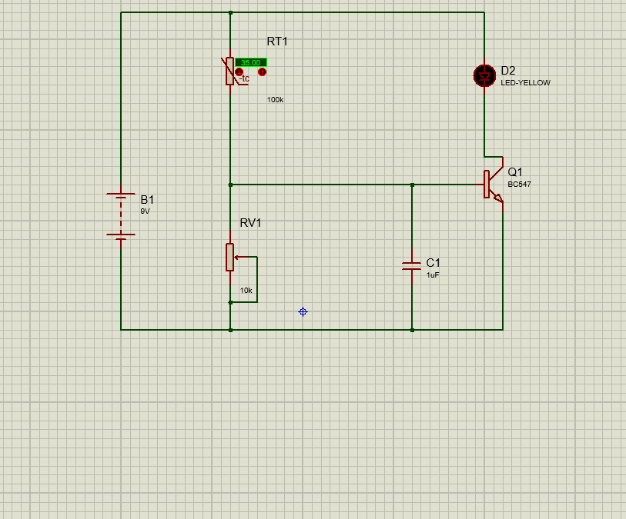
Screenshot of simulation results BEFORE SIMULATION

Slide 26
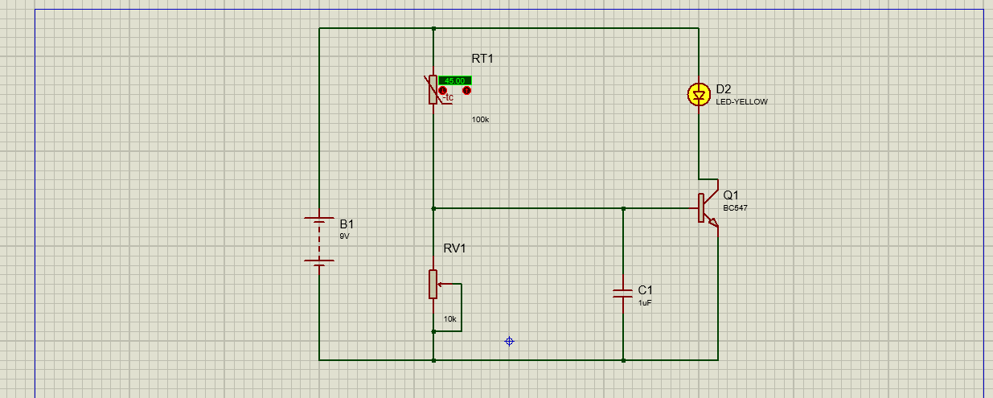
AFTER SIMULATION

Slide 27
HARDWARE IMPLEMENTATION

Slide 28
Code for node mcu
#include <Adafruit_MLX90614.h> #include <LiquidCrystal_I2C.h> Adafruit_MLX90614 mlx = Adafruit_MLX90614(); //Define I2C address of lcd, number of columns and rows LiquidCrystal_I2C lcd(0x3F, 16, 2); const int buzzer=D3; double temp_obj; void setup() { Serial.begin(9600); Serial.println("Temperature Sensor MLX90614"); //Initialize LCD I2C lcd.init(); lcd.backlight(); pinMode(buzzer,OUTPUT); //Initialize MLX90614 mlx.begin(); } void loop() { temp_obj = mlx.readObjectTempC(); if(temp_obj > 37) { Serial.print("Warning...HIGH TEMP..."); lcd.clear(); lcd.print("HIGH TEMP..."); digitalWrite(buzzer,HIGH); delay(100); digitalWrite(buzzer,LOW); delay(50); } else { } lcd.clear(); lcd.print("Body Temp:"); delay(1000); lcd.clear(); lcd.print(temp_obj); Serial.print("Object temp = "); Serial.println(temp_obj); delay(1000); }

Slide 29
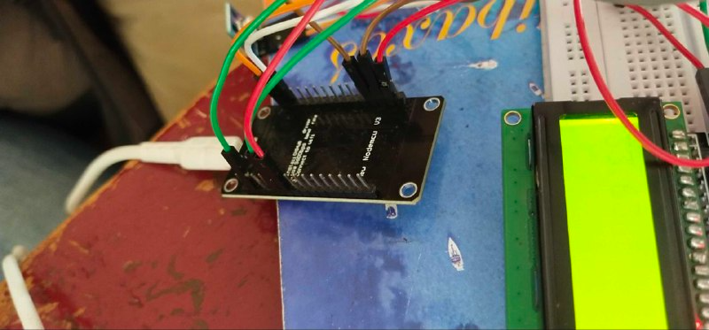
after working NODE MCU AND LCD

Slide 30
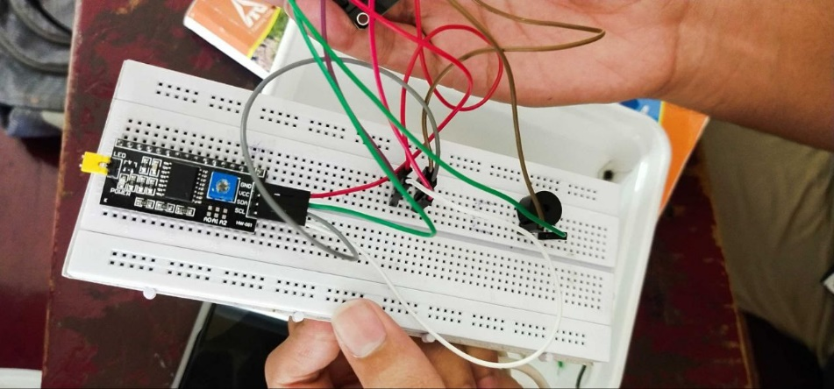
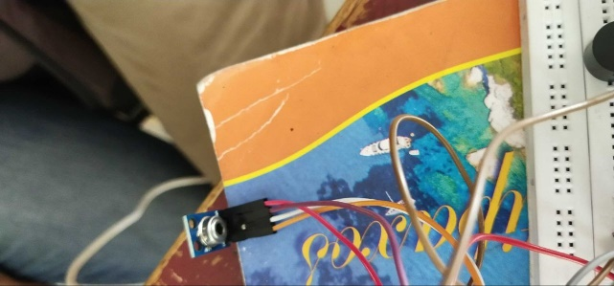
I2C MODULE
MLX90614 Non-contact Infrared Temperature Sensor

Slide 31
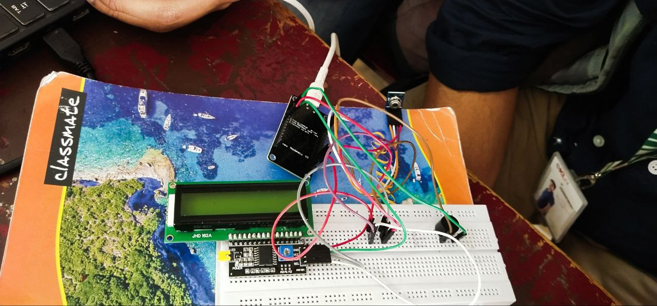
before working.

Slide 32
Hardware Components
The following components are required to make Circuit
S. No | Components | Quantity
1. | Node mcu | 1
2. | LCD | 1
3. | BUZZER | 1
4. | I2C MODULE | 1
5. | MLX90614 | 1

Slide 33
SUMMARY CONCLUSION AND FUTURE SCOPE
In this project, we have proposed a solution to The automatic signal and alarming system to avoid battery overheating has been successfully designed and developed. Compared to other conventional methods, this system shows excellent performance with its reliable digital technology and it is cheaper and durable. The automatic overheat alarm and signal system is a promising system in terms of engine temperature response in the sensor, micro-controller and LCD. Thus the automatic signal and alarming system for overheating is a big boon as concerned with the automobile engine, aviation engine, generator, power plant, nuclear power plant and industrial applications. It increases engine-life and saves economical expenses. Based on the survey result, it is seen that the signal and alarming system has a rising demand and it is a good asset from the electronics perspective
Integration of active and passive cooling systems: Active cooling systems use fans and pumps to move air or coolant around key components, while passive cooling systems rely on natural heat dissipation. Future thermal management systems for EVs may combine both approaches to maximize efficiency and reliability.
Use of advanced materials: New materials with high thermal conductivity and low thermal resistance may be developed and incorporated into thermal management systems to enhance heat transfer and reduce overall system weight.
Improved control systems: Advanced control algorithms and machine learning techniques can optimize the performance of thermal management systems by predicting and adjusting for changes in driving conditions and component loads.
Integration with vehicle-to-grid (V2G) systems: Thermal management systems can be designed to facilitate V2G services by enabling bidirectional power flow and managing battery temperatures during charging and discharging.
Modular designs: Modular thermal management systems can enable more flexible and cost-effective vehicle designs, allowing for easier component upgrades and replacements.

Slide 34
Current status of project
Currently we are able to perform the simulation of this experiment.
We have given the connection for our project as per the circuit diagram.
So we were able to complete the simulation successfully.
We are looking for any improvements can be done that we can use for the solution.
The relay module is working as with respect to the inputs.

Slide 35
CONCLUSION-LEARNINGS
We have learned about the different components available in to understand about thermal management system
We have learned about the thermal management uses and applications
We have learned about how different components are available in different software libraries and how are they extracted to proteus software.

Slide 36

Thank you

